Slide 1
Societal impact of recreational Marijuana
Exploring metrics for measuring the social, financial, and public health impacts of recreational marijuana legalization.
Andrew Hardy, David Centa, Sarah Grabinski, Richard Varos

Slide 2
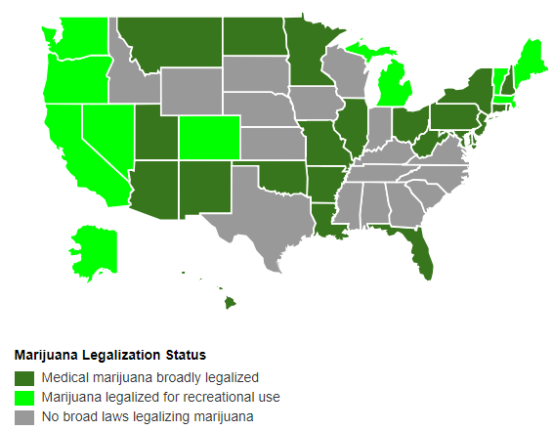
Has the legalization of recreational marijuana had an impact?
Colorado - passed by voters on November 6, 2012 and sales began in January 2014.
Washington - passed by voters on December 6, 2012 and sales began in July 2014.
Metrics
Crime
School Financing
Opioid Abuse
Population
Control: states as of 2018 who have no legalized marijuana (medical or recreational)

Slide 3
Data Sources
Population - US Census Bureau (https://www.census.gov)
School Financing - US Census Bureau Annual Survey of School System Finances https://www.census.gov/programs-surveys/school-finances/data/tables.html
Opioid raw data: Kaiser Family Foundation analysis of Centers for Disease Control and Prevention (CDC), National Center for Health Statistics. Multiple Cause of Death 1999-2016 on CDC WONDER Online Database, released 2017. Data are from the Multiple Cause of Death Files, 1999-2016, as compiled from data provided by the 57 vital statistics jurisdictions through the Vital Statistics Cooperative Program. Accessed at [http://wonder.cdc.gov/mcd-icd10.html](http://wonder.cdc.gov/mcd-icd10.html) on January 31, 2018.
Crime Data- FBI Uniform Crime Reporting (UCR)
https://www.fbi.gov/services/cjis/ucr

Slide 4
Data Exploration and Cleanup - Population
Did changes in Marijuana Laws affect population trends in states analyzed?
The overall population in the United States increased throughout the data period, 2012-2016.
Census data was available in spreadsheet form to help analyze these trends. The date needed to filtered for the years and states. The percentage change was calculated to compare trends in the individual states and the country in aggregate.
All of the subject states showed above average population growth with stronger growth in the states that passed recreational laws in 2014.

Slide 5
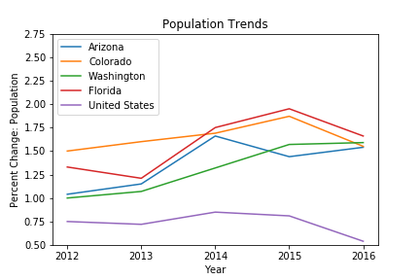
Analysis - Population

Slide 6
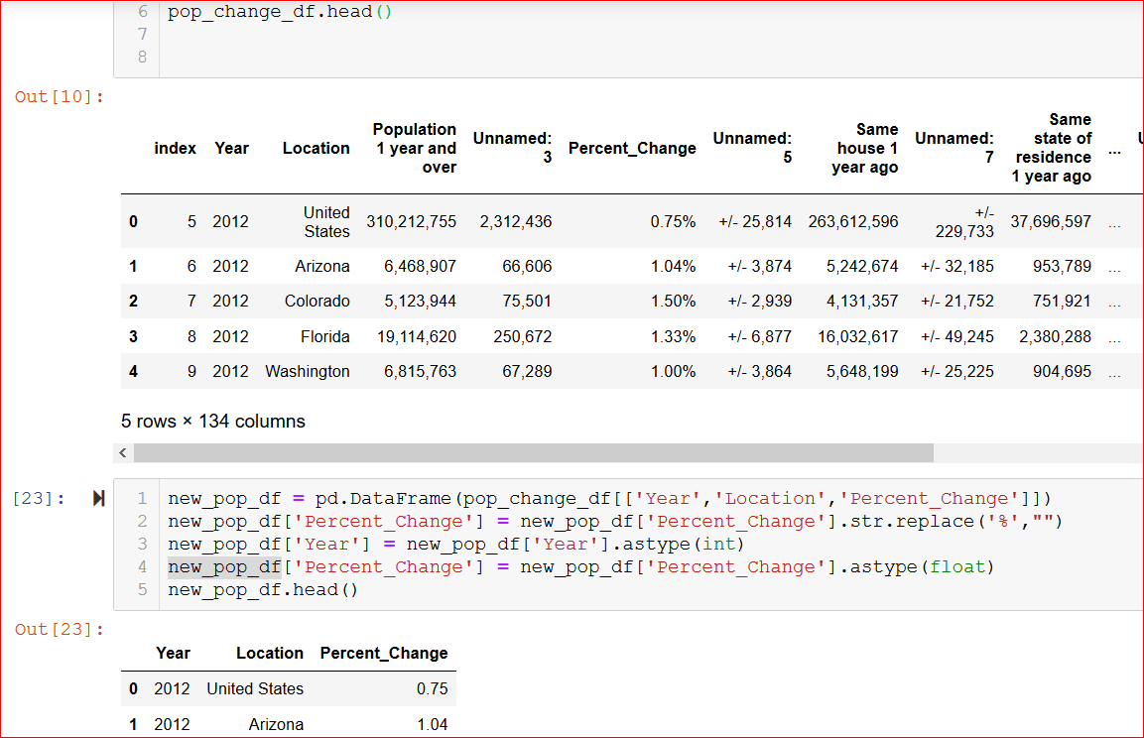
Population Trends: Script and DataFrame

Slide 7
Crime
Do we see any changes in the crime rates after the legalization of recreational marijuana?
Fewer drug arrests could result in more resources focused on violent crime.
More people using marijuana could result in changes in the rates of violent crime.
Does legalization of marijuana correlate with higher or lower violent crime rates?
Legal state statistics compared to non-legal state rates.

Slide 8
Data Exploration and Cleanup - Crime
Data is sourced from the Uniform Crime Reporting csv files provided by the FBI to compile a list of violent crime types; by state and by year.
The UCR Program's primary objective is to generate reliable information for use in law enforcement administration, operation, and management; over the years, however, the data have become one of the country’s leading social indicators.
Violent Crime
Aggravated Assault
Homicide
Rape
Robbery
Property Crime
Motor Vehicle Theft
Burglary
Larceny
Note: Only 44% of the agencies in the country report crime incident data to the FBI (URC). Disclosing this to show the limitations of our dataset, but most of the non-reporting cities are smaller stations.

Slide 9
Crime Data cleanup
Sorting the data into two dataframes; one with legal states: Washington (2013), Florida (2017), Colorado (2013), Arizona (2010)
and the other containing the data of non-legal states; Idaho, Wyoming, South Dakota, Nebraska, Texas, Kansas, Iowa, Wisconsin, Indiana, Kentucky, Tennessee, Virginia, North Carolina, South Carolina, Georgia, Alabama, Mississippi.
To standardize the data and make the rates comparable to one another we took the incidents of each crime type of the legal states and divided by their populations multiplying by 1000 to give us an incident rate per 1000 people.
With the other non-legal states we combined the incident counts of each crime type and divided by the combined populations of the states.

Slide 10
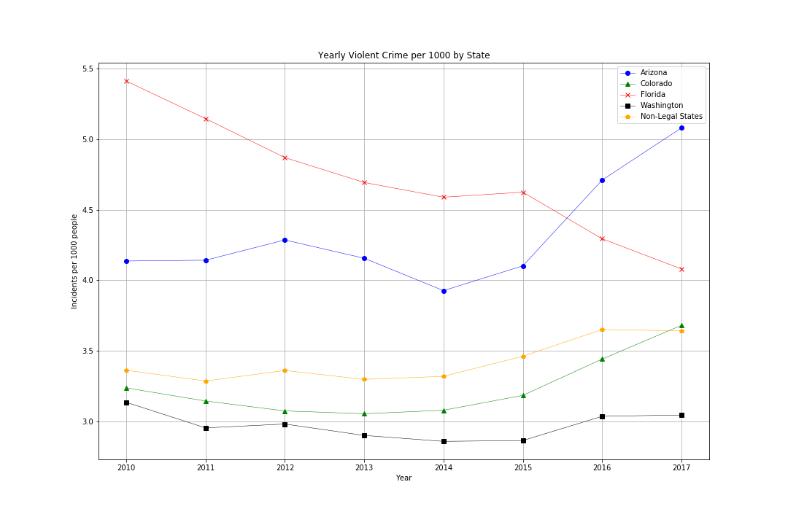
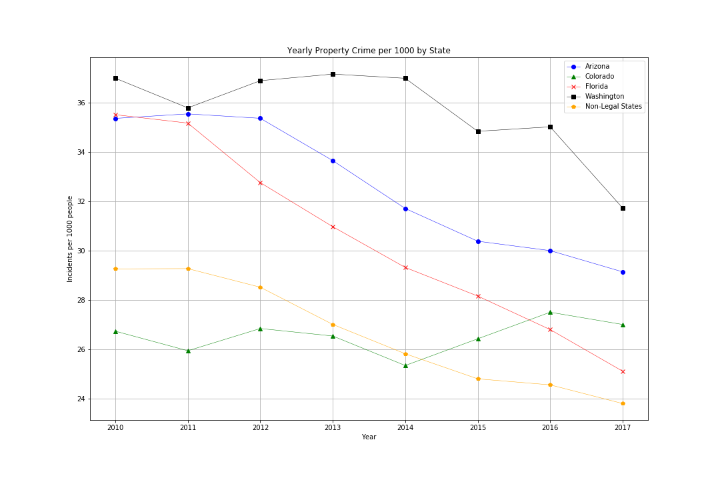
Crime Data Visualized
Violent Crime rates are seeing a mixed changed over the years, with FL falling drastically while AZ rises drastically. CO saw a 13% increase since 2015.
Property crime has been falling in every state beside Colorado. Hard to denote the cause of this trend.

Slide 11
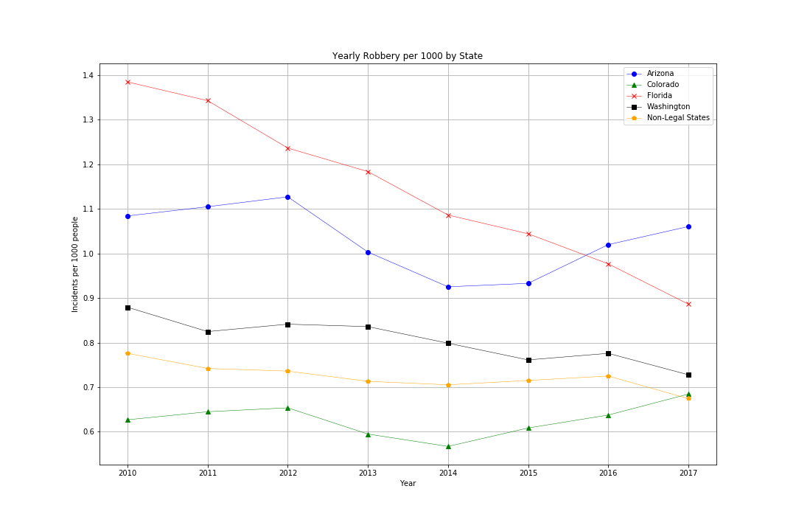
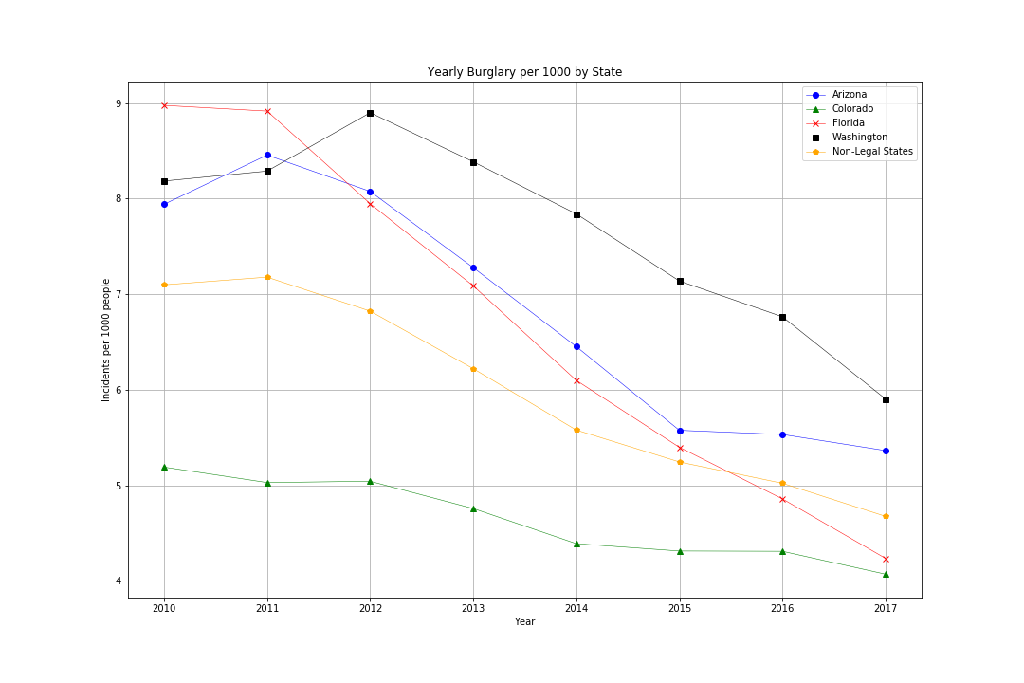
Robbery seems to be on a downward trajectory in most states, interestingly there seems to be an uptick in Colorado and Arizona
Unlike Robbery, Burglary across the board is falling drastically.

Slide 12
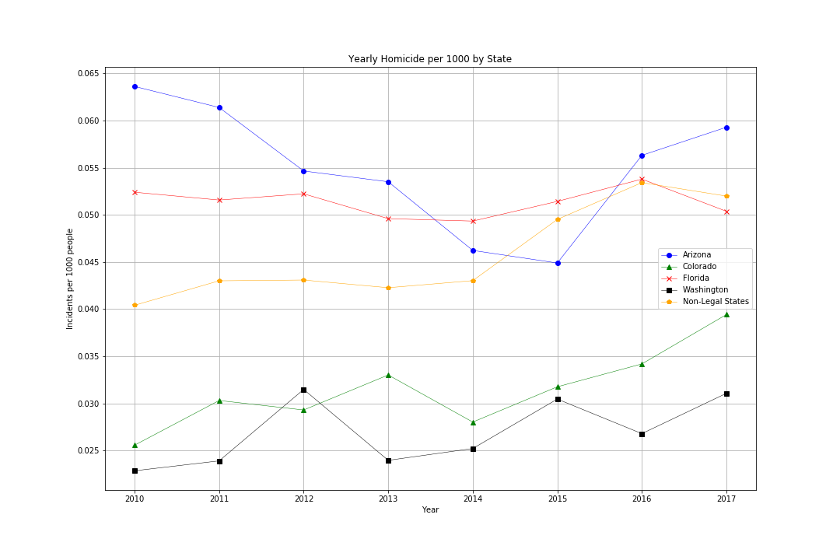
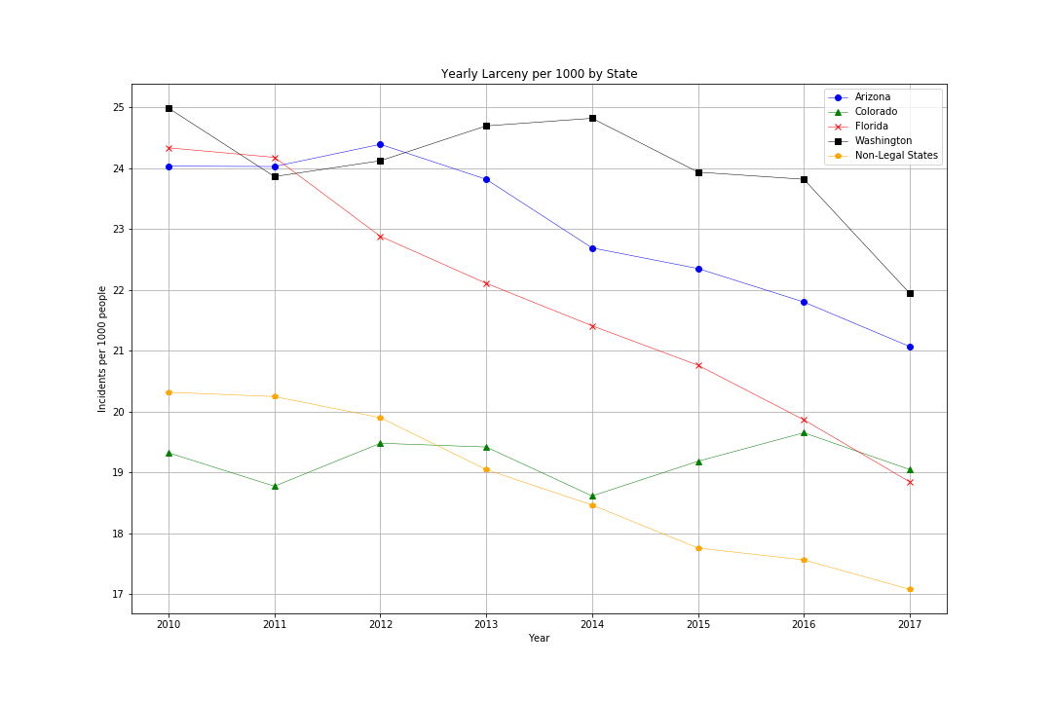
Homicide rates rose across the boards, with the non-legal MJ states growing at a similar pace with the legal states.
Larceny, theft of personal property not by force, has been falling across the board with the exception of Colorado, remaining steady.

Slide 13
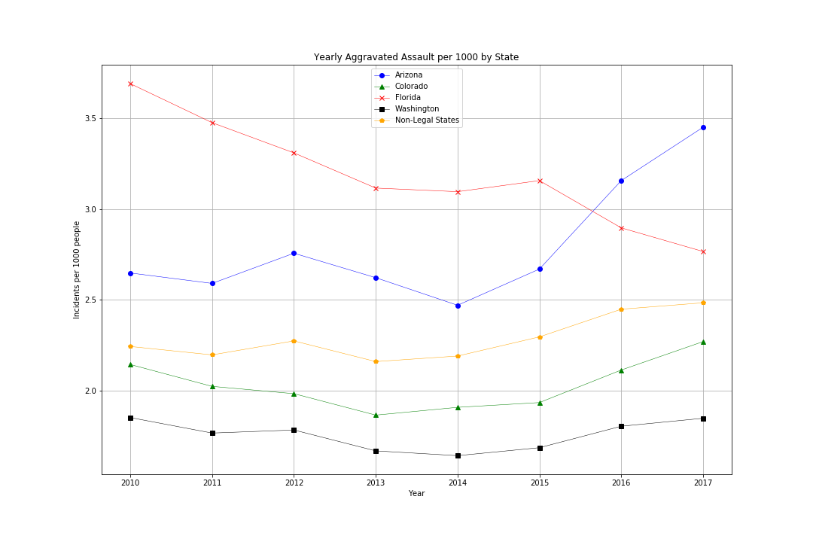
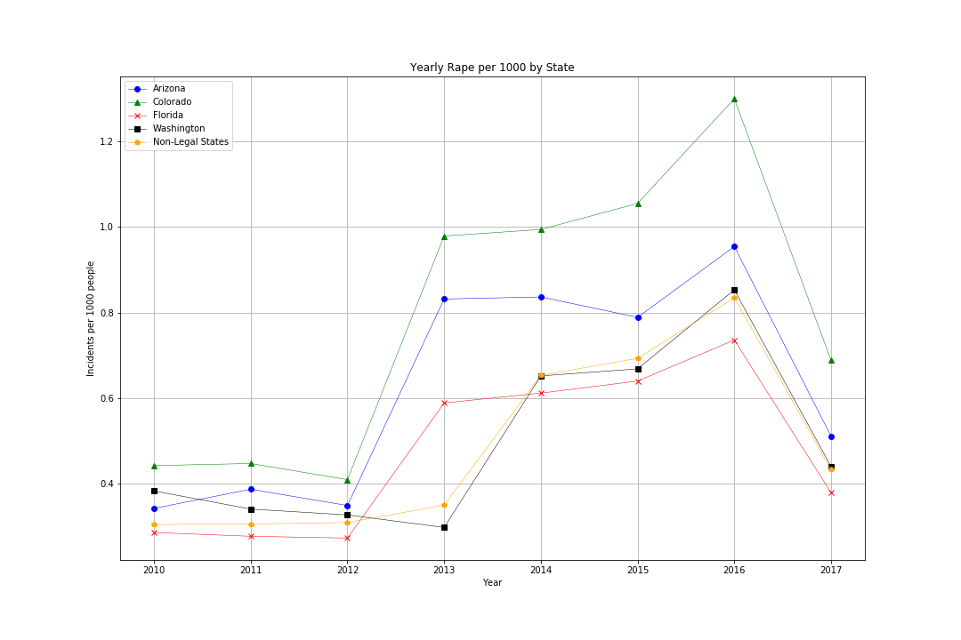
Aggravated Assault saw varying changes across the states. AZ rising more that 30% since 2014 and CO rose as well.
Rape saw a dramatic increase across the board, but this could be due to an expansion in the definition of rape.

Slide 14
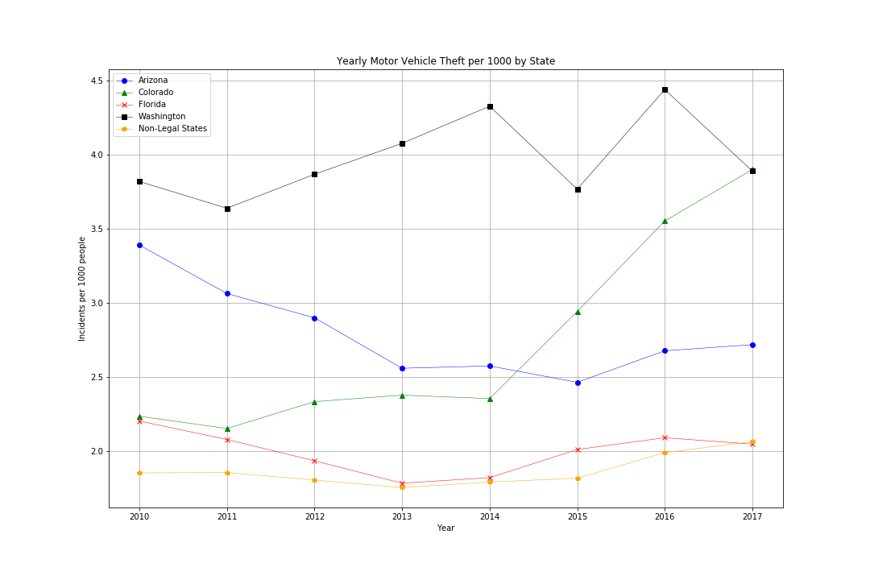
Note: Colorado’s motor vehicle theft rate rose dramatically in this time period

Slide 15
Analysis - Crime
With the data on hand, we can see trends between the crime data of Marijuana legal states and non-marijuana legal states.
According to our data, the trends we identified were above average increases in violent crimes, homicides, aggravated assaults, and motor vehicle thefts rates in states with Marijuana being legal.
Though, there is no way to know if marijuana legalization was the cause, there seems to be a small trend between recreational and medicinal marijuana becoming legal in a state and increases in violent crime, homicide, aggravated assaults, and motor vehicle theft rates.

Slide 16
School Financing
Colorado
The first $40M of the Retail Marijuana Excise Tax revenue was distributed to the Public School Capital Construction Assistance Fund. Excise tax collections in excess of $40M, $2.5M for FY 2015-16, were transferred to the Public School Fund.
12.59% of special sales tax on retail marijuana goes to State Public School Fund distributed to all school districts.
Does the addition of revenue from taxes on marijuana sales impact public elementary-secondary education finances?
Revenue
Expenditures
Outstanding Debt
Cash and securities on hand

Slide 17
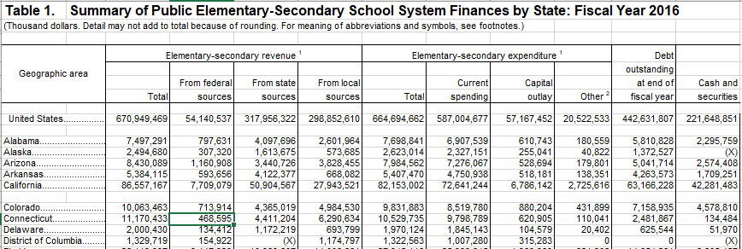
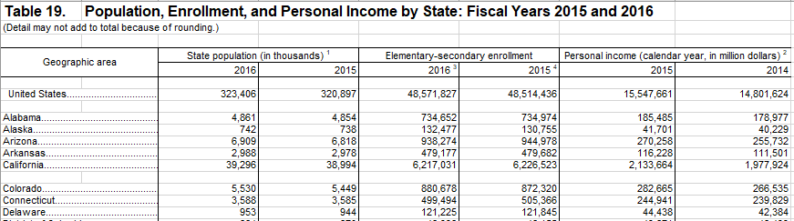
Data Cleanup - School Financing
Data was already available in Excel, required small modifications to convert to csv
Controlled for differences in size by dividing by pupil enrollment

Slide 18
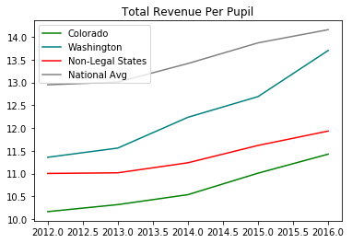
Analysis - School Financing - Revenue
Plotted Colorado and Washington vs states with no legalized marijuana in aggregate
Used national average as baseline for overall trends
Compared federal, local, and state sources of revenue

Slide 19
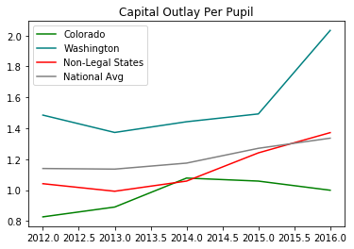
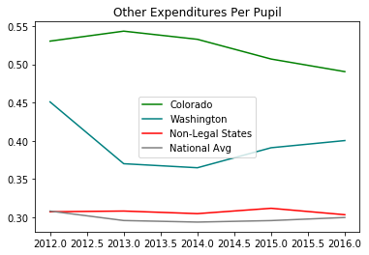
Analysis - School Financing - Expenditures
Plotted Colorado and Washington vs states with no legalized marijuana in aggregate
Used national average as baseline for overall trends
Capital Outlay - expenditure for construction of buildings, roads, other improvements

Slide 20
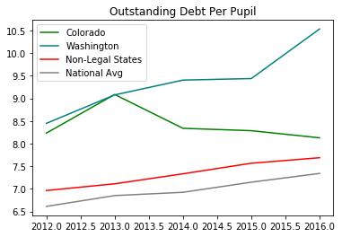
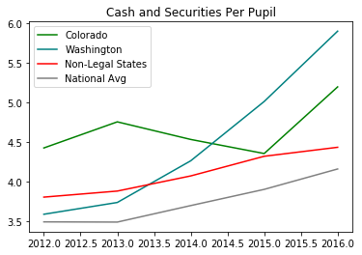
Analysis - School Financing - Solvency
Plotted Colorado and Washington vs states with no legalized marijuana in aggregate
Used national average as baseline for overall trends
Outstanding Debt and Cash & Securities

Slide 21
Conclusions & Implications
The impact of tax revenues from marijuana on overall revenue in Colorado is inconclusive.
Millions of dollars vs $10 billion budget
Early sales may be impacted by developing infrastructure (dispensaries, growers, etc.)
Sales and tax revenues will continue to grow as infrastructure expands
We actually see a decrease in capital outlay expenditures.
Was money previously appropriated for building and development reallocated with the addition of a new revenue source?
News from Colorado from that time also investigates the marginal impact of revenues
Solvency appears to improve between 2014-2016
As “spillover” contributions to the Public School Fund increase, will this continue?

Slide 22
Opioid Abuse
Do we see a change in total number of opioid overdose deaths following the passage of laws legalizing the recreational use of marijuana?
Is the percentage change in opioid overdose deaths affected in any way due to the legalization of recreational marijuana?
How do these changes compare between states that have not passed laws permitting the recreational use of marijuana (Idaho, Wyoming, South Dakota, Nebraska, Texas, Kansas, Iowa, Wisconsin, Indiana, Kentucky, Tennessee, Virginia, North Carolina, South Carolina, Georgia, Alabama, Mississippi), the national average, and states that have passed such laws (Colorado, Washington)?
Washington - Half that intake in fiscal 2015, 2016, and 2017 went to the Basic Health Plan Trust Account. - providing “necessary basic health care services to working persons and others who lack coverage, at a cost…that does not create a barrier to…utilization …”
Washington - 15% of tax revenue to Department of Health Substance Abuse Programs, 10% to Department of Health Marijuana Education & Public Health Programs

Slide 23
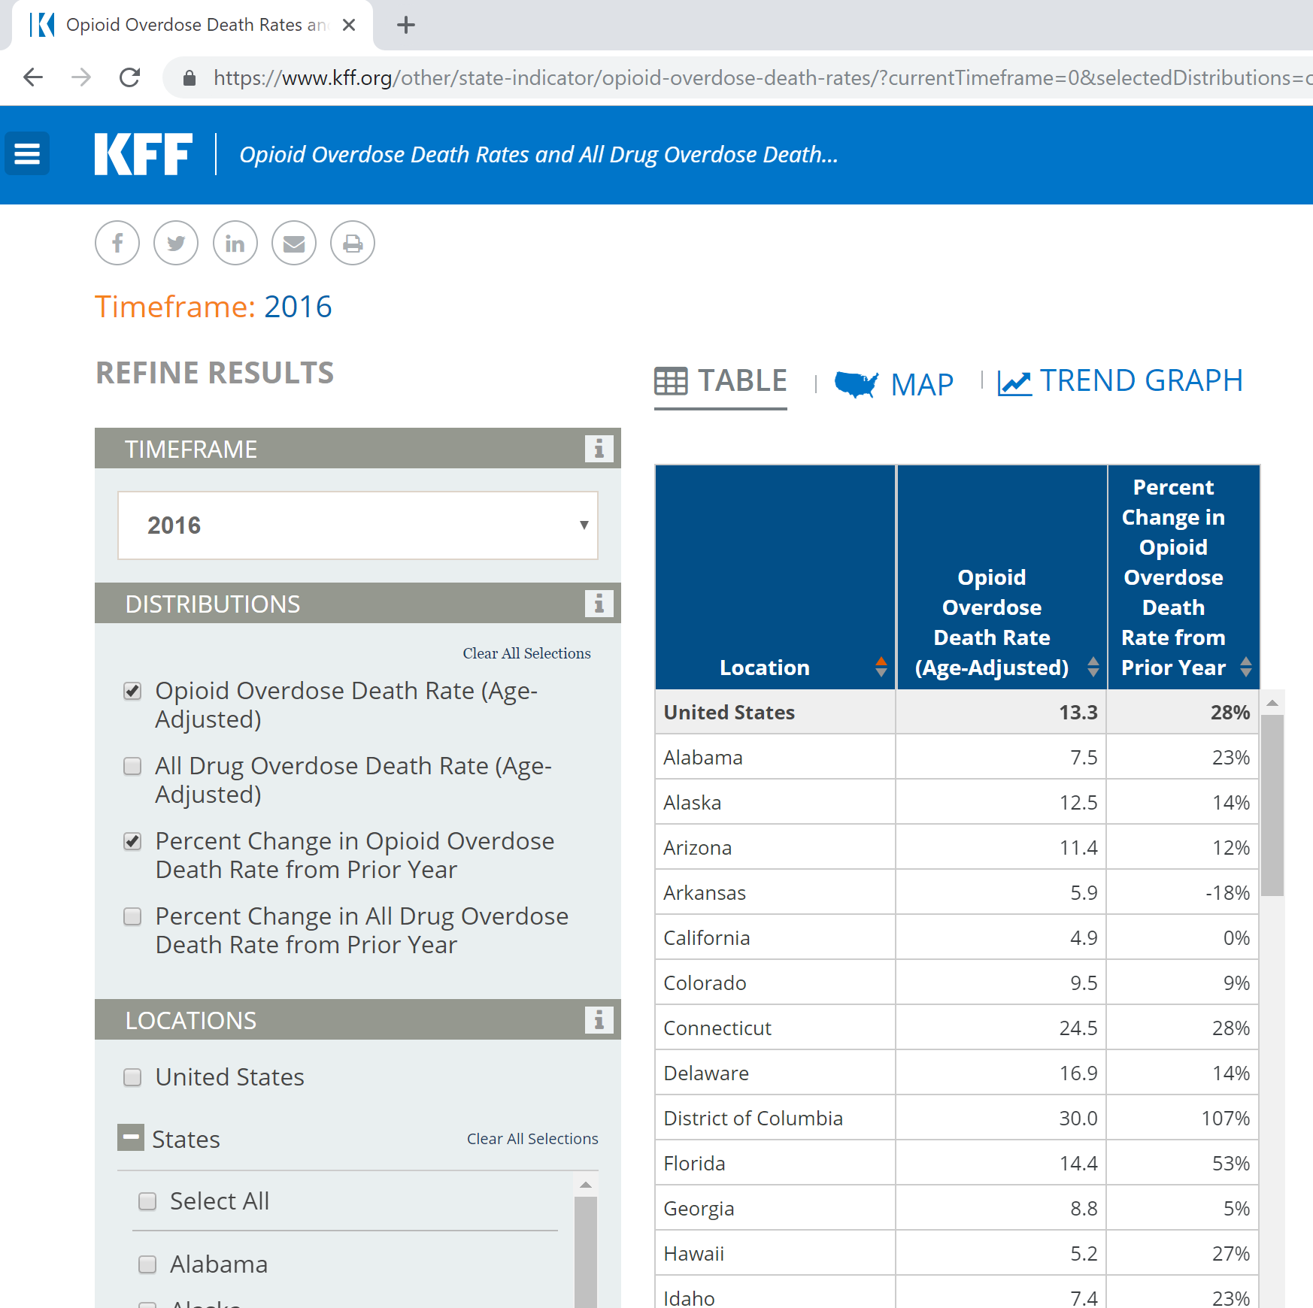
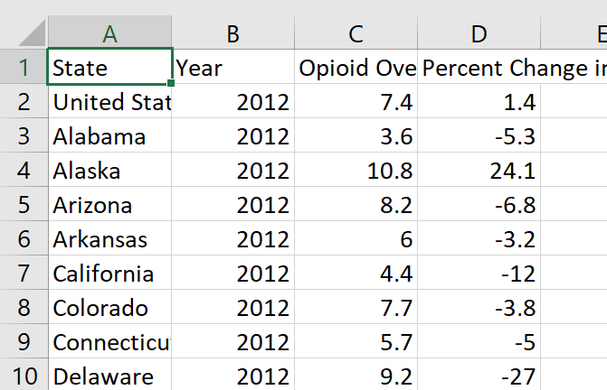
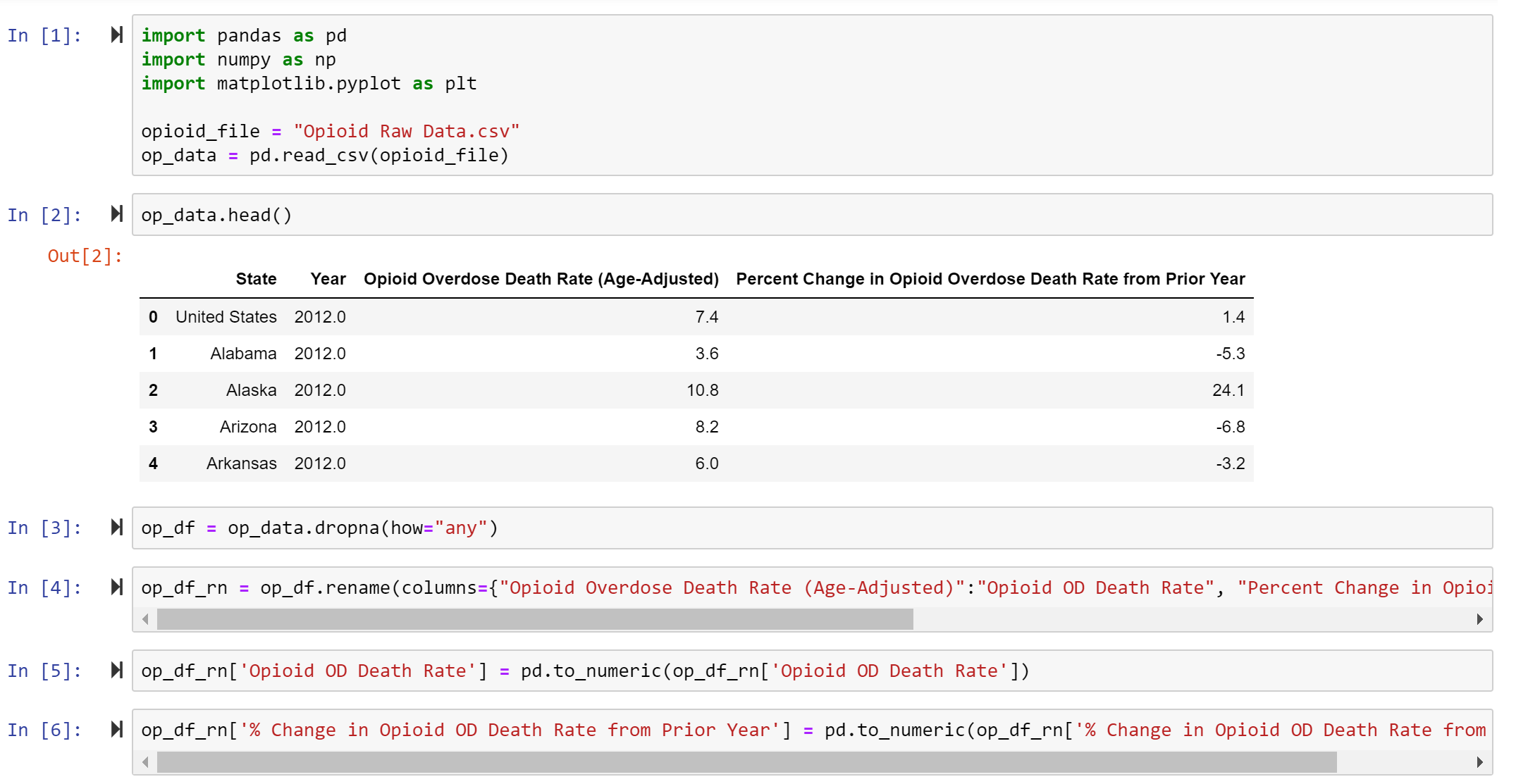
Data Exploration and Cleanup - Opioid Abuse

Slide 24
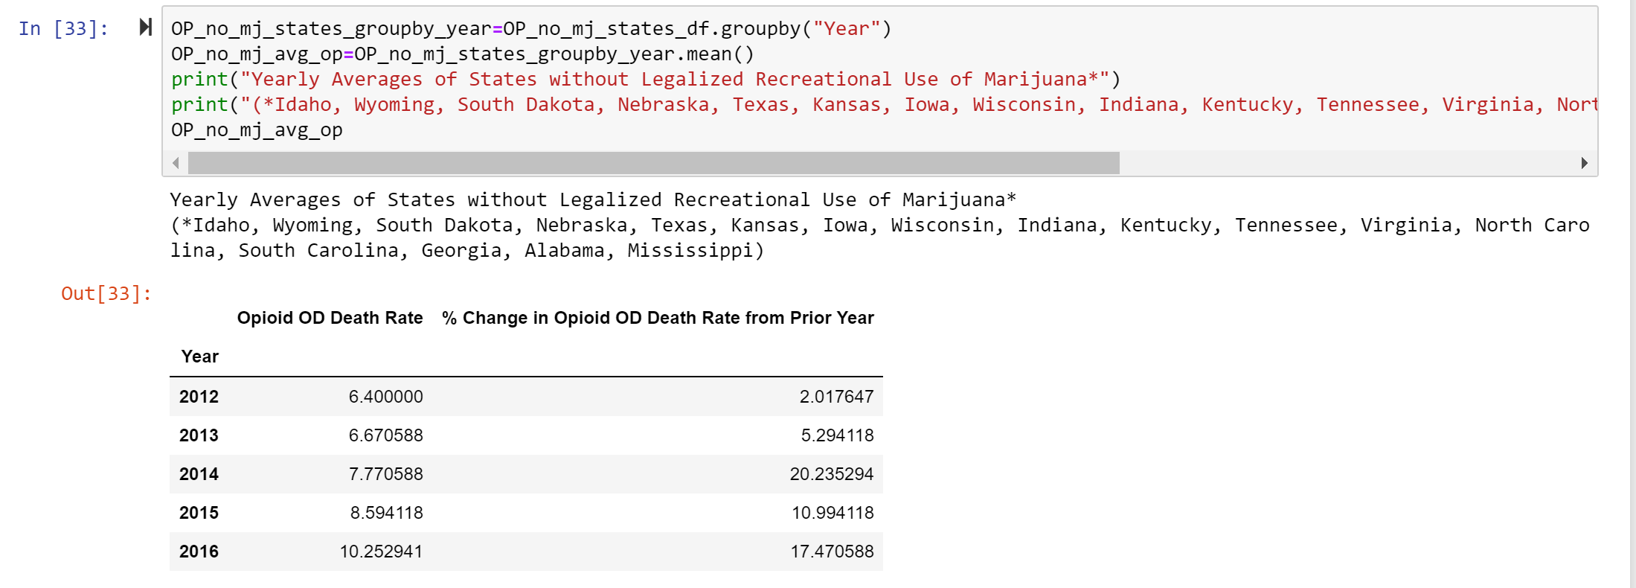
Data Exploration and Cleanup - Opioid Abuse

Slide 25
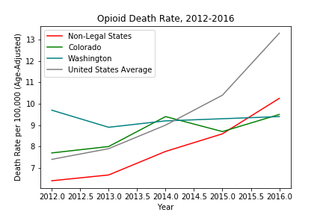
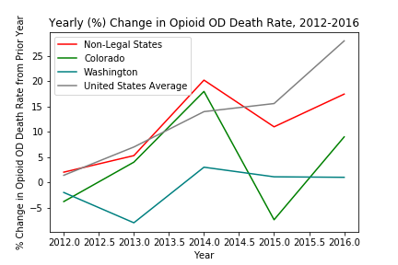
Analysis - Opioid Abuse
(*Non-legal states: Idaho, Wyoming, South Dakota, Nebraska, Texas, Kansas, Iowa, Wisconsin, Indiana, Kentucky, Tennessee, Virginia, North Carolina, South Carolina, Georgia, Alabama, Mississippi)

Slide 26
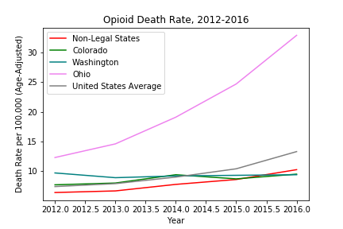
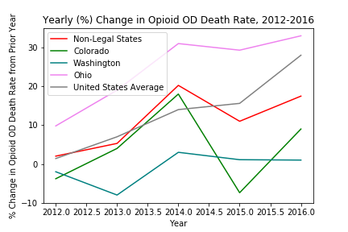
Data Exploration and Cleanup - Opioid Abuse

Slide 27
Conclusions
Based on the information and graphs provided, the death rate from opioid overdoses increased in non-marijuana states and for the United States. Colorado saw its death rate from opioid overdoses initially decrease after 2014, increasing slightly in 2016. Washington’s opioid overdose death rate decreased after 2013, increasing slightly up to 2016.
The percentage change in the opioid overdose death rate for both non-marijuana states and the United States increased over time, declining for non-marijuana states in 2015, but increasing again in 2016. The percentage change in the opioid overdose death rate for Colorado and Washington both saw an initial decrease in 2014. Colorado’s percentage change increased in 2016, however, Washington’s percentage change continued to drop.

Slide 28
Other Metrics to Explore
Drug Crimes - raw data not immediately available/couldn’t find
Employment - do new jobs surrounding the recreational marijuana industry reduce unemployment?
Hospitality Industry
Does the food and beverage industry benefit from recreational marijuana?
Do we see any growth thanks to “marijuana tourism”?

